Slide 1






The art of Stokes inversions
Basilio Ruiz Cobo
Instituto de Astrofísica de Canarias, Spain
Boulder (CO) 15-26 May 2017

Slide 2
Outline
PART 1: Theory
1. The RTE: formal solution & approximations
2. The Response Functions (RF)
3. What is an inversion technique? How does it work?
4. The SIR code.
6. How to choose an inversion technique?
7. Running SIR
Input files
Visualization of observations, fits, and model atmospheres
Tips and tricks
PART 2: SIR exercises

Slide 3
Files
You can download the SIR code, and all the files to run it from:
https://github.com/BasilioRuiz/SIR-code
And the slides and exercises from
https://github.com/BasilioRuiz/SIR-course

Slide 4
1) The RTE
RTE:
Absorption coefficient: χ_{ν} = ( χ_{ff +} χ_{bf} ) + χ_{bb} φ(ν)
χ_{c}
Emission: η_{ν}
Optical depth: dτ_{ν}= − χ_{ν} ds
Continuum optical depth: dτ_{c}= − χ_{c} ds
Suppose no emission :
Optical depth: dτ_{ν}= − χ_{ν} ds (number of mean free path at ν)
Continuum optical depth: dτ_{c}= − χ_{c} ds (number of mean free path at continuum)
Suppose no emission :

Slide 5
1) The RTE
RTE:
Continuum optical depth: dτ_{c}= − χ_{c} ds

Slide 6
1) The RTE
RTE:
Continuum optical depth: dτ_{c}= − χ_{c} ds

Slide 7
1) The RTE
RTE:
Continuum optical depth: dτ_{c}= − χ_{c} ds
S_{ν}
per cm
per gram

Slide 8
1) The RTE

Slide 9
1) The RTE
Formal solution: integration factor O

Slide 10
1) The RTE
Formal solution: integration factor O

Slide 11
1) The RTE

Slide 12
1) The RTE

Slide 13
1) The RTE
, depend on the atomic populations n=n[T, P, )] SE equations
Some possible approximations:
LTE: n=n[T, P] &
Milne- Eddington (ME) approximation: =cte,

Slide 14
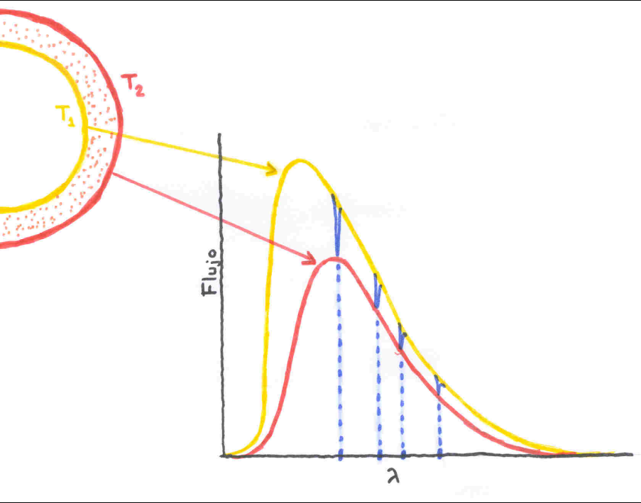
1) The RTE
Spectral lines: Temperature gradient
Negative gradient: absorption lines
Positive gradient: emission lines
Core: upper layers
Wings, Continuum: deeper layers

Slide 15
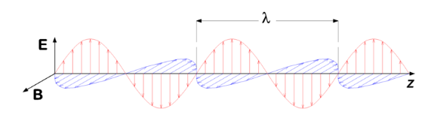
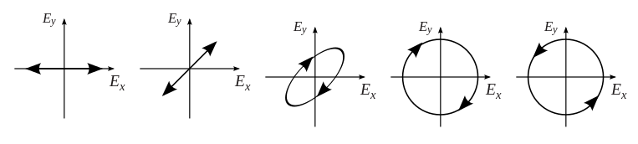
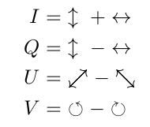
1) The RTE

Slide 16
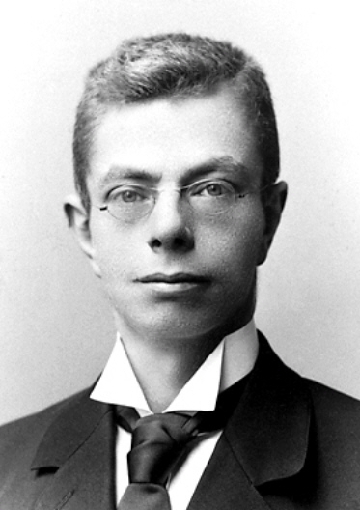
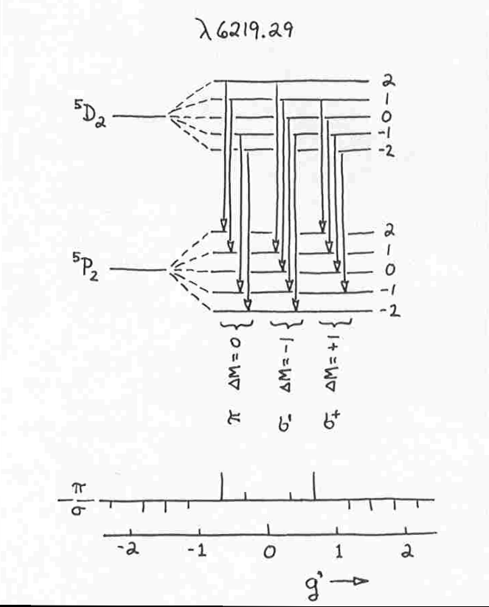
1) The RTE
Pieter Zeeman (1865-1943)

Slide 17
1) The RTE

Slide 18
1) The RTE
2000 G, 45º

Slide 19
1) The RTE
2000 G, 45º

Slide 20
1) The RTE

Slide 21
1) The RTE
Landi Degl’Innocenti & Landi Degl’Innocenti (1981)

Slide 22
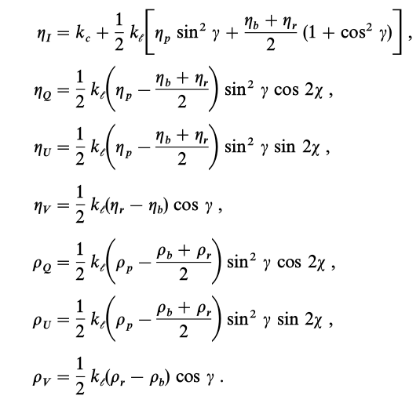
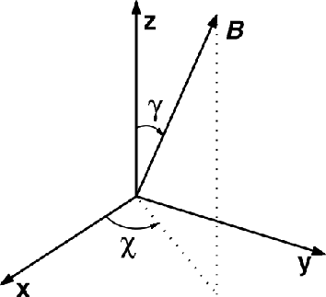
1) The RTE
Landi Degl’Innocenti & Landi Degl’Innocenti (1981)

Slide 23
1) The RTE

Slide 24
2) Response Functions
&
depend on atmosphere
Can we evaluate, in first order, how much change when we perturb x= ?

Slide 25
2) Response Functions

Slide 26
2) Response Functions

Slide 27
2) Response Functions

Slide 28
2) Response Functions

Slide 29
2) Response Functions

Slide 30
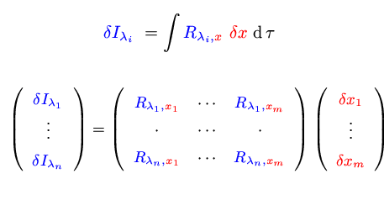
2) Response Functions
Table of physical magnitudes
+ atomic parameters
+ scenario
+ approximations
+ physical laws
Synthesis
(solving RTE)
&

Slide 31
What is an inversion technique?
Any method used to infer the physical conditions of the atmosphere from the interpretation of Stokes profiles
Weak-field approximation, center-of-gravity method...
Forward modeling
PCA, artificial neural networks
Least-squares fitting
What we want: vector magnetic field, gas temperature, gas velocity
What to expect: a model atmosphere capable of reproducing the observations…. nothing else!

Slide 32
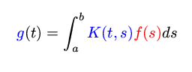
What is an inversion technique?
-What’s an IT?
Fredholm’s inhomogeneous ec. first kind:
g(t) data
K(t,s) kernel
f(s) unknown
This equation, through a quadrature, becomes:
K f = g
as g is no null if we could evaluate K ⁻¹
the solution: f = K ⁻¹ g but… this is not the general case

Slide 33
What is an inversion technique?
f(s) become smoothed by the kernel K(t,s)
1) Small g(t) perturbations are compatible with huge changes in f(s)
2) Smoothing means lost information, then “recover” f(s) is imposible
3) We have a discrete set of g(t) values and we’d wish a function f(s)

Slide 34
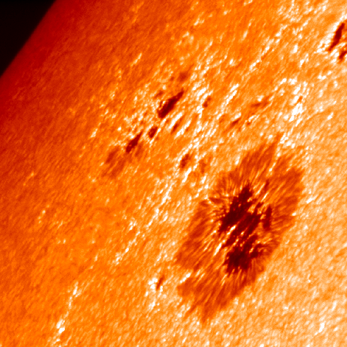
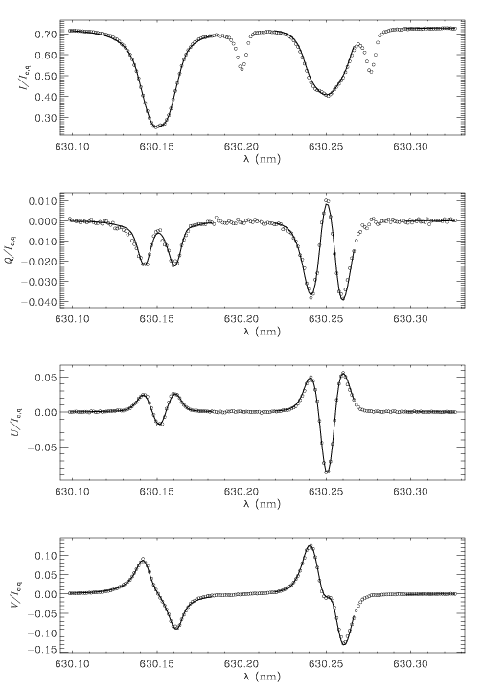
What is an inversion technique?
Observation

Slide 35
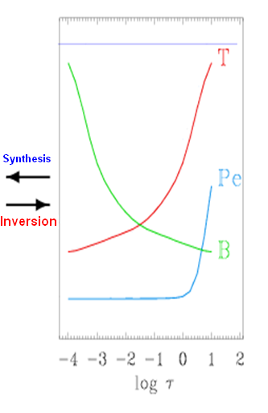
What is an inversion technique?
MODEL
Approximations:
Atomic parameters
Plasma Physics ecs
stationary
plane-paralel
LTE
HE…
+

Slide 36
What is an inversion technique?
The model (except free parameters values ) must be known a priori
We only fit the free parameters
Observation
MODEL
Approximations:
Atomic parameters
Plasma Physics ecs
+
stationary
plane-paralel
LTE
HE…

Slide 37
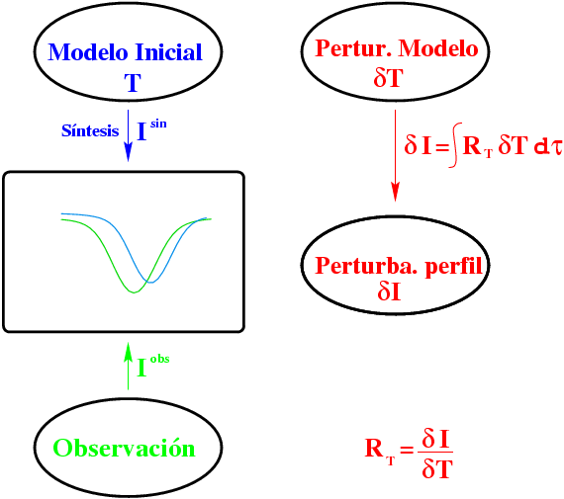
SIR inversion technique
Initial model
T
Model perturbation
δT
Synthesis I^{syn}
Profile perturbation
I^{obs}
Observation

Slide 38
SIR inversion technique
Initial model
T
Model perturbation
δT
Synthesis I^{syn}
Prof. perturb.
= I^{syn}-I^{obs}
I^{obs}
Observation

Slide 39
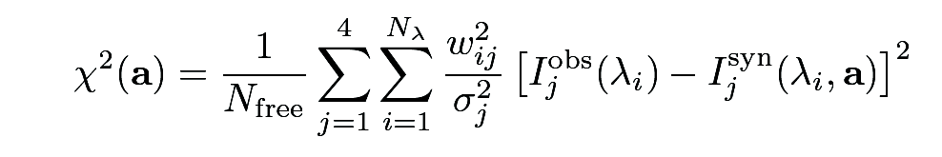
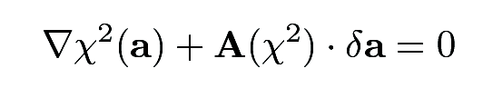
SIR inversion technique
Inversion driven by χ²-minimization
Minimization: 2nd order Levenberg-Marquardt algorithm

Slide 40
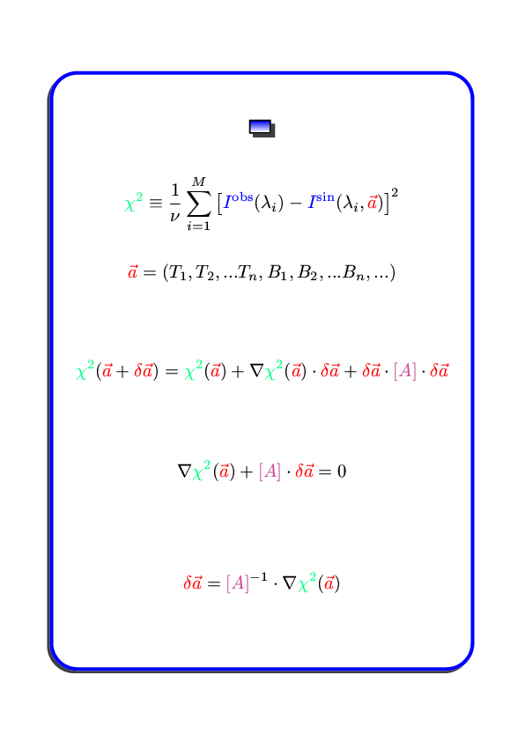
SIR inversion technique
Least squares
= -

Slide 41
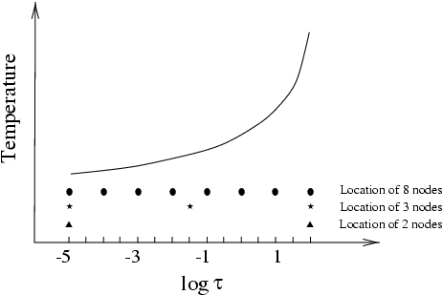
SIR inversion technique
Very large (1)
Singular (2)
inverting A
1) Sequential increase of unknown number

Slide 42
SIR inversion technique
inverting A
Very large (1)
Singular (2)
1) Sequential increase of unknown number
2) Singularities elimination through SVD (Singular Value Decomposition)
A = U W V ^{T} with U & V ortonormal matrix
y W =diagonal(W_{j j} )
A⁻¹= V W ⁻¹ U ^{T} with W ⁻¹ =diagonal(1/W_{j j} )
but doing (W ⁻¹ )_{j j} =0 si W_{j j} ≅ 0

Slide 43
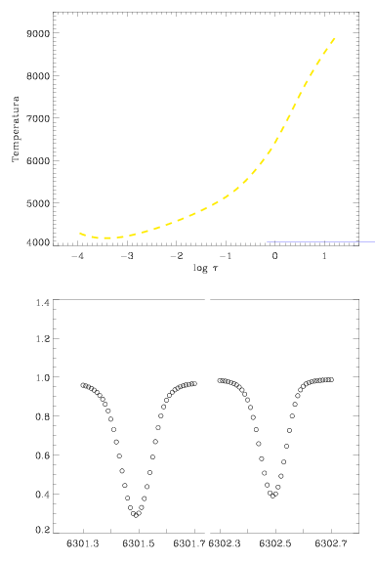
SIR inversion technique
The “real” SUN
Synthetic “observations”

Slide 44
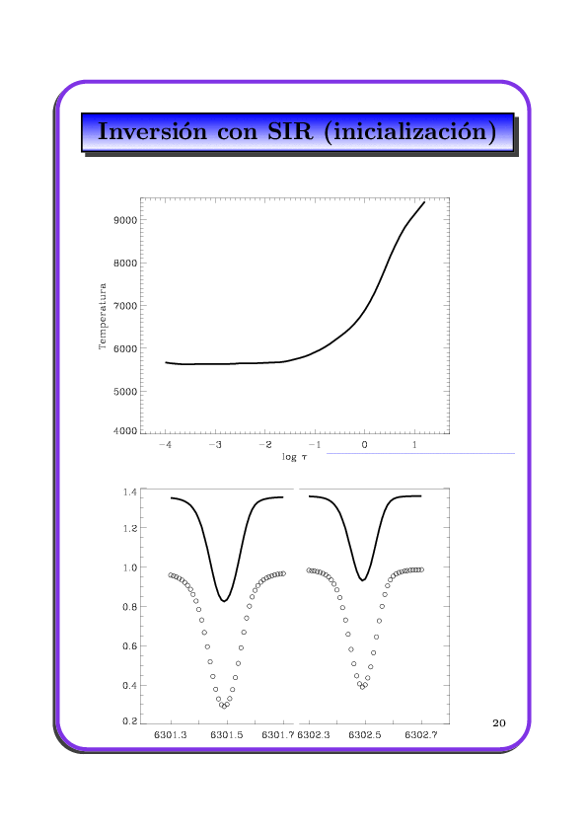
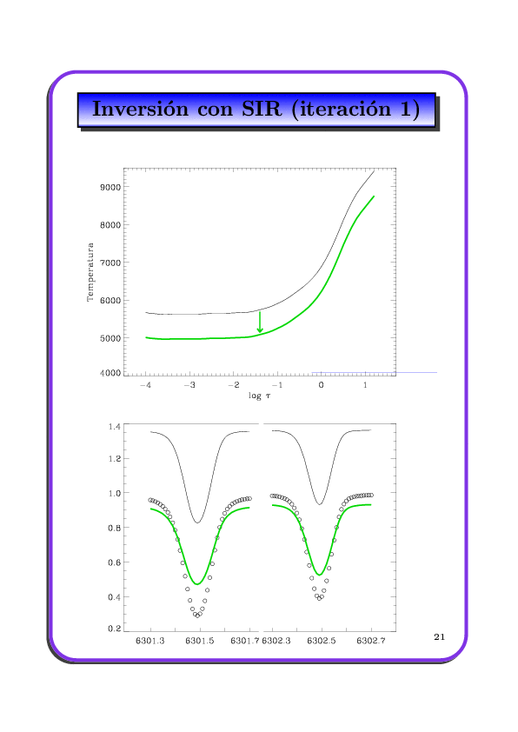
SIR inversion technique
Initial guess model

Slide 45
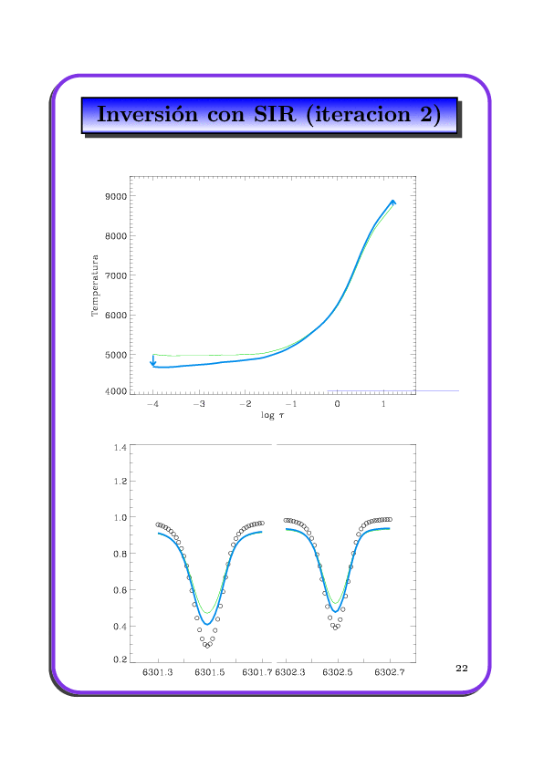
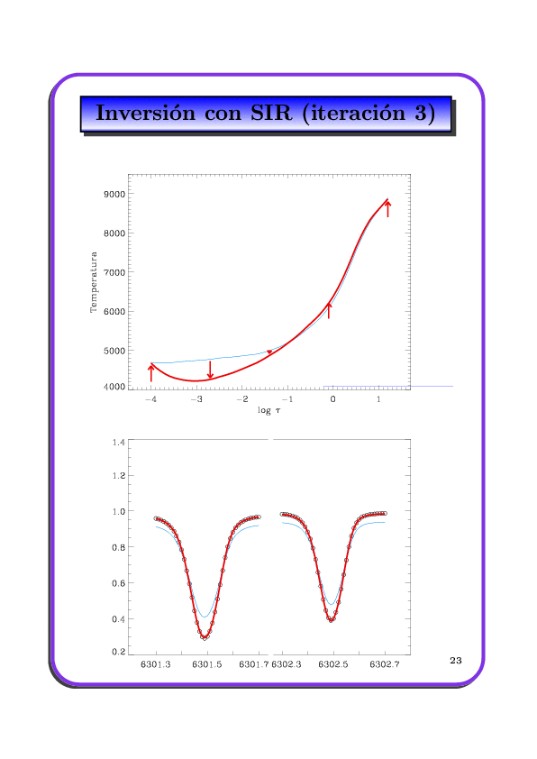
SIR inversion technique

Slide 46
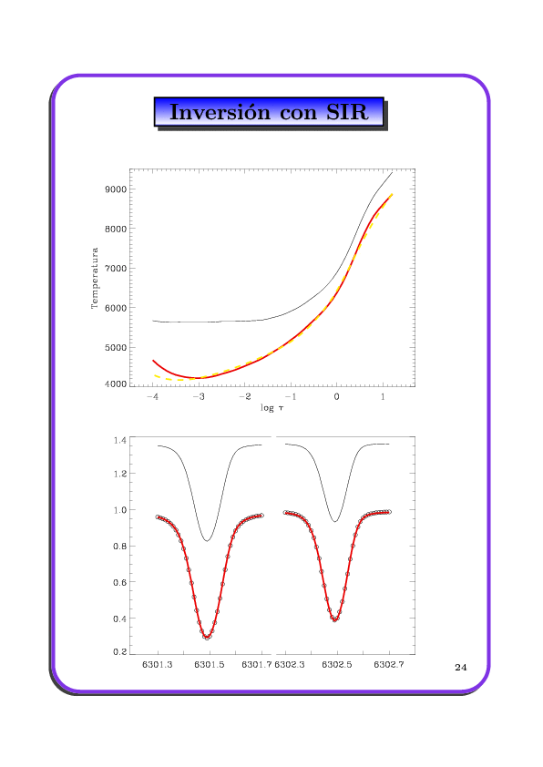
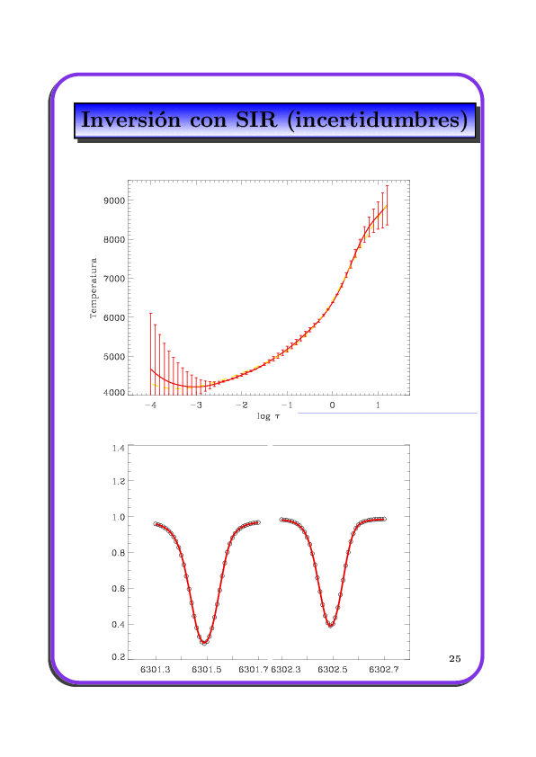
SIR inversion technique

Slide 47
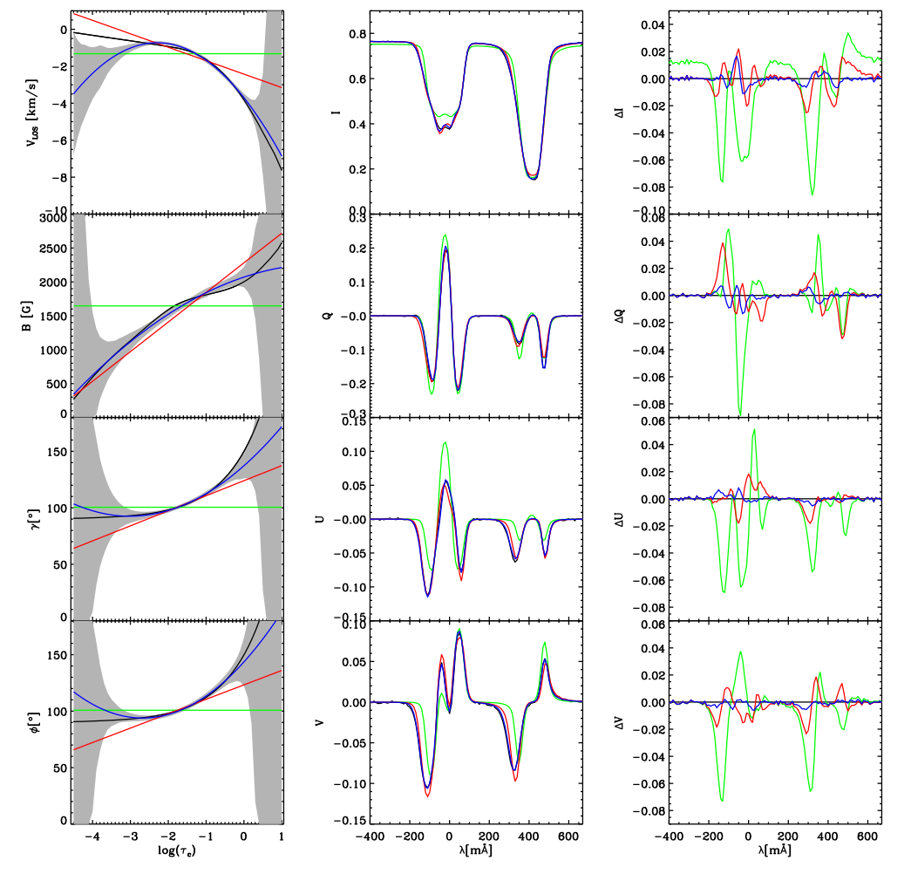
nodes(T, B)
2,1
4,2
6,3
Observation

Slide 48
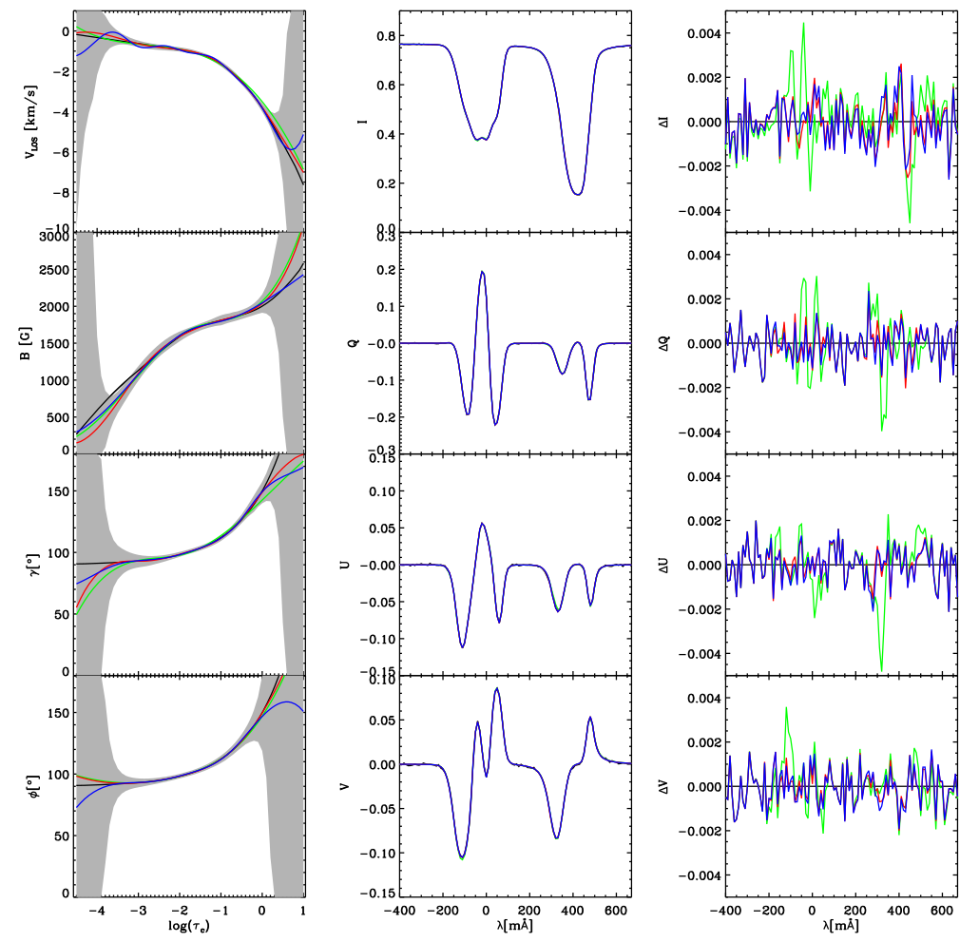
nodes(T, B)
7,5
9,7
Automatic
Observation

Slide 49
How to choose an inversion technique
Some Reviews:
Socas Navarro (2001) ASP Conf Series 236, 487
del Toro Iniesta (2003) Astronomische Nachrichten 324, 383
Bellot Rubio (2006) ASP Conf Series, 358, 107
Ruiz Cobo (2007) ‘Modern Solar Facilities’, Göttingen
Asensio Ramos et al (2012) ApJ 748, 83
del Toro Iniesta & Ruiz Cobo (2016) Livings Reviews in Solar Physics, 13,4

Slide 50
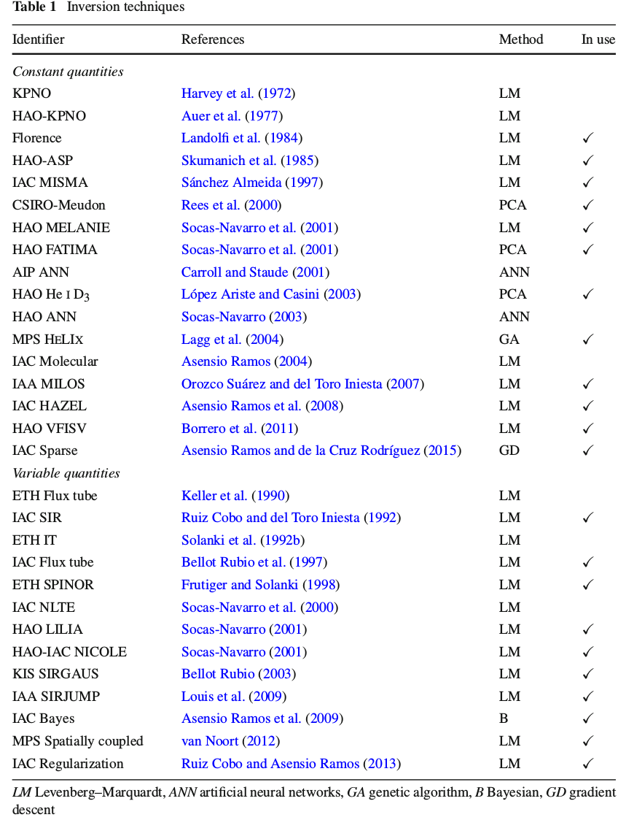
How to choose an inversion technique

Slide 51
How to choose an inversion technique

Slide 52
How to choose an inversion technique
People usually select an inversion method for strange reasons: if the code is available, if it is easier or faster than others, (or was written for my boss), etc., instead of selecting the most convenient for each specific problem.
I classify available IT in 3 families:
ME must be used in case in which you do not know the physics controlling the line formation, or you have few wavelength points for each pixel.
PCA when you need fast results.
SIR (or similar) when you believe that your knowledge of the formation of the lines used is appropriate (and/or you be plenty of time or you be… a little crazy.)

Slide 53
How to choose an inversion technique
ME family
Skumanich & Lites (1984, 1987) ; Landolfi (1984); Lagg et al (2004)
Extensively used in HAO (ASP data).
Advantages: - fast (a typical map takes ~ hr).
- simple use & easy interpretation of results.
- robust & reliable.
- HE, LTE etc approximations are not needed.
Shortcoming: - unable to fit asymmetric Stokes profiles. (but: robust against noise)
- no gradients. (but: even theoreticians understand the results)
- no temperature, pressure & density information.
(but: no physics knowledge is required)
- the number of free parameter grows with the number of spectral lines
(but: no excuses!)
Juanma Borrero told me that his ME code inverts a 1000x1000 Hinode data in just 3 min.

Slide 54
How to choose an inversion technique
2. SIR family (a lot of children): an incomplete list
Ruiz Cobo & del Toro Iniesta (1992): SIR code
Frutiger, Solanki et al (2000): SPINOR code [see also Bernasconi & Solanki (1996)]
Bellot Rubio, Ruiz Cobo & Collados (1997): FT geometry [see also Frutiger & Solanki (1998)]
Bellot Rubio (2003) [see also Borrero, Lagg, Solanki & Collados (2005)]: Uncombed penumbral model
Socas Navarro, Trujillo Bueno & Ruiz Cobo (2000): SIR-NLTE code
Sánchez Almeida et al (1996): MISMA code
Allende Prieto, Ruiz Cobo & García López (1998): MISS code [see also Frutiger et al (2000), Rüedi et al (1997)]

Slide 55
How to choose an inversion technique
2. SIR family
Advantages: - Arbitrarily complex along line of sight (gradients, multicomponents, etc)
- Thermodynamic information.
- adaptation to many geometries & scenarios.
- LTE/NLTE, HE, mass conservation etc.
- uncertainties estimation.
Shortcoming:- Slow (20-30 times slower than ME)
(but: new SIR version –upcoming soon!!- will nearly reach ME rates)
- Difficult use
(but: for simplified problems –like only linear stratifications-- is straightforward)
- Unicity (but: only if you are ambitious)

Slide 56
How to choose an inversion technique
3. PCA family
Look-up-table inversion method, based in PCA
Rees et al (2000); Socas Navarro et al (2001); López Ariste & Casini (2002)
Since 2004 used in THEMIS for real-time inversions
Advantages: - extremely fast (one order of magnitude faster than ME)
- simple use, robust & reliable
Shortcoming: - few free parameter determination (ME)
- slightly more inaccurate that ME inversions

Slide 57
Conclusions
How to choose an inversion technique
ME must be used in case in which you do not know the physics controlling the line formation or few spectral points.
PCA when you need fast results.
SIR (or similar) when you believe that your knowledge of the formation of the lines used is appropriate.

Slide 58
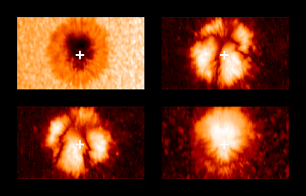
Parámetros de Stokes medidos con TIP

Slide 59
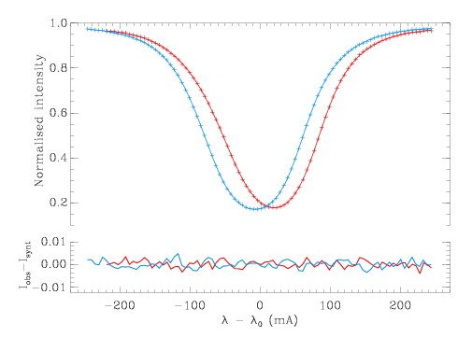
5’ oscillation (SIR inversion)

Slide 60
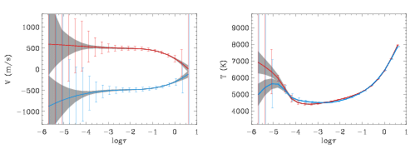
5’ oscillation (SIR inversion)

Slide 61
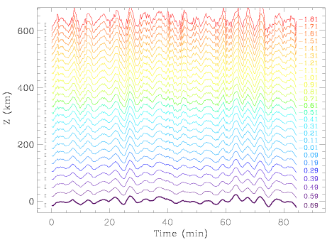
5’ oscillation (SIR inversion)

Slide 62
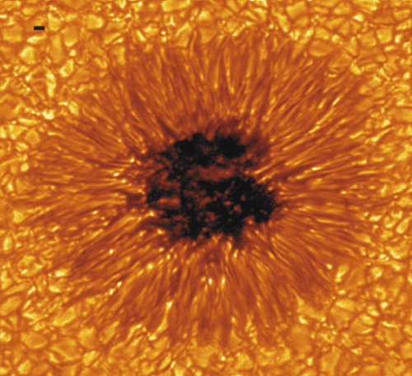

Slide 63
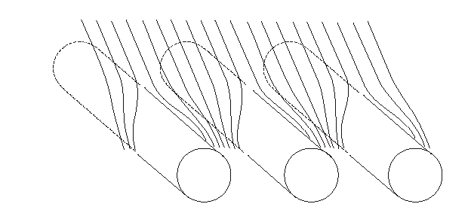
The structure of the penumbra

Slide 64
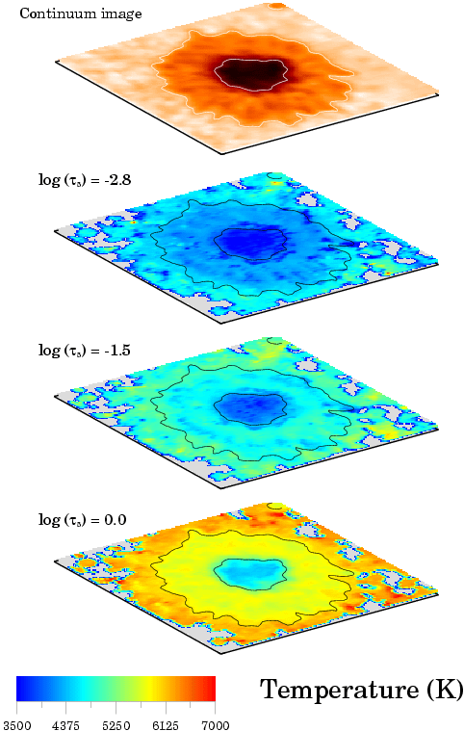
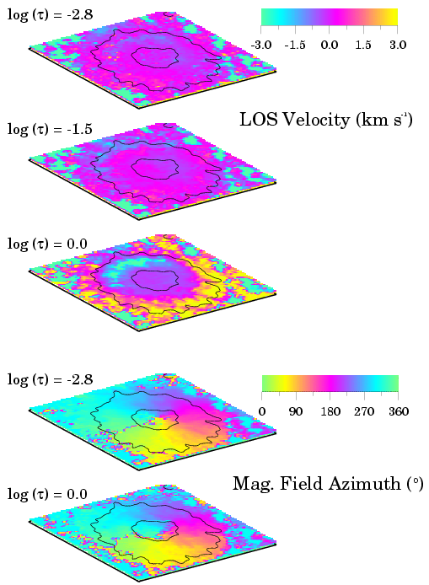
Sunspot (SIR inversion)

Slide 65
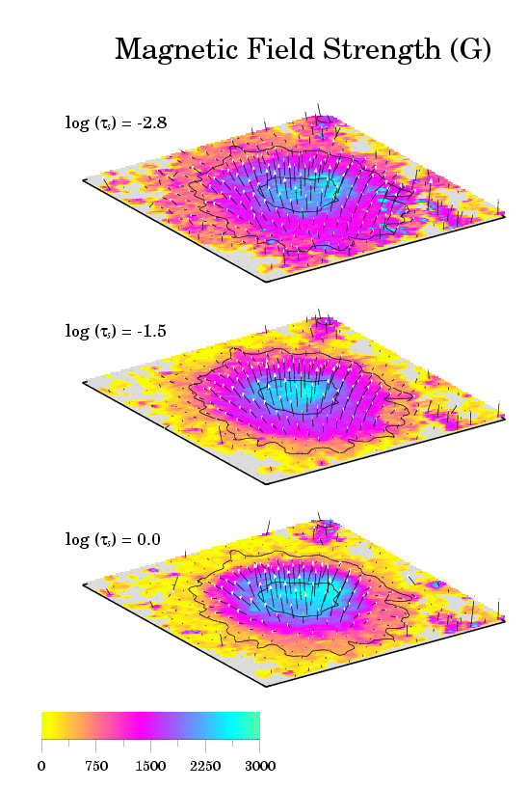
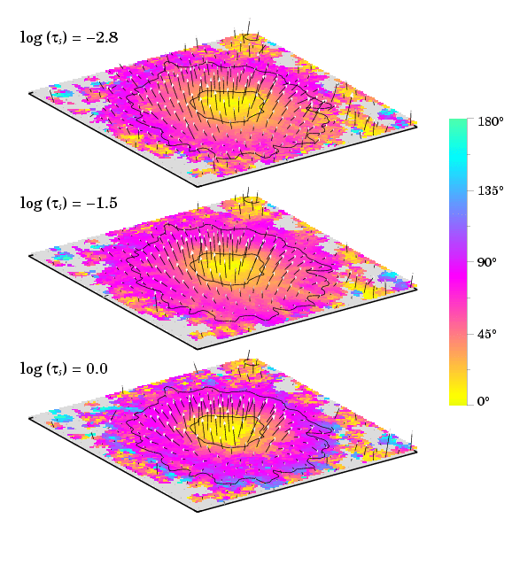
Sunspot (SIR inversion)
Magnetic field Inclination (º)
Magnetic field strength (G)

Slide 66
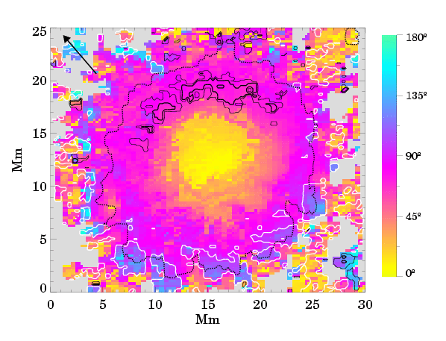
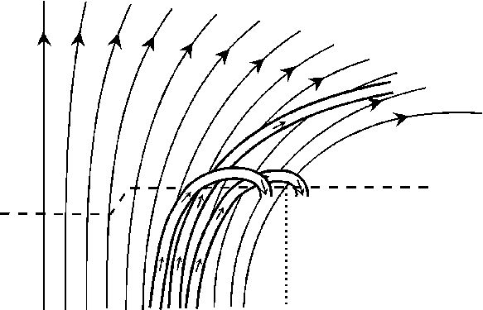
Sunspot (SIR inversion)
Westendorp Plaza et al (1997) Nature

Slide 67
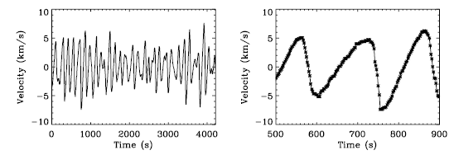
ApJ (2006), 640,1153

Slide 68
ApJ (2006) 638, 539

Slide 69
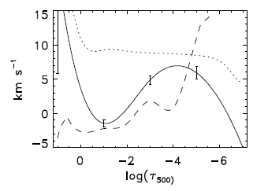
Present IMs

Slide 70
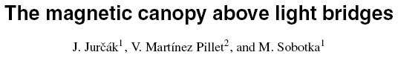
A&A (2006) 453,1079

Slide 71
Present IMs

Slide 72
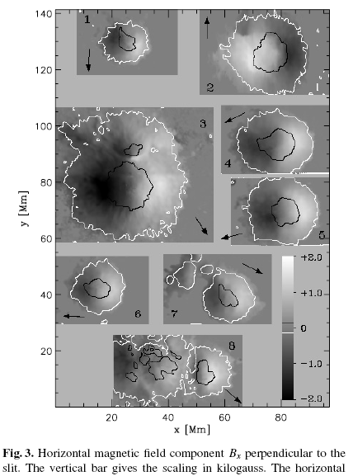
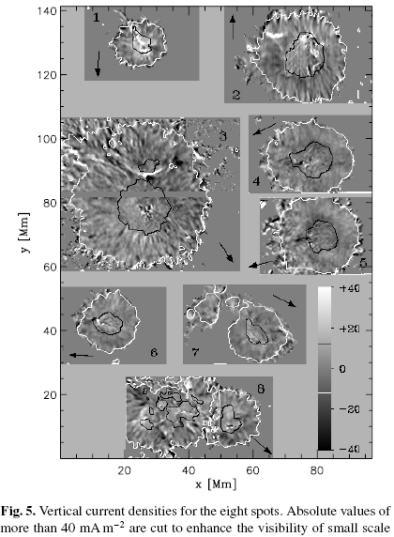

Slide 73
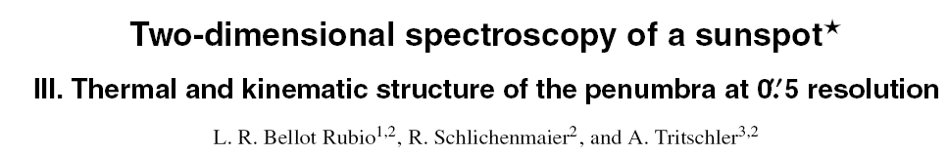

Slide 74
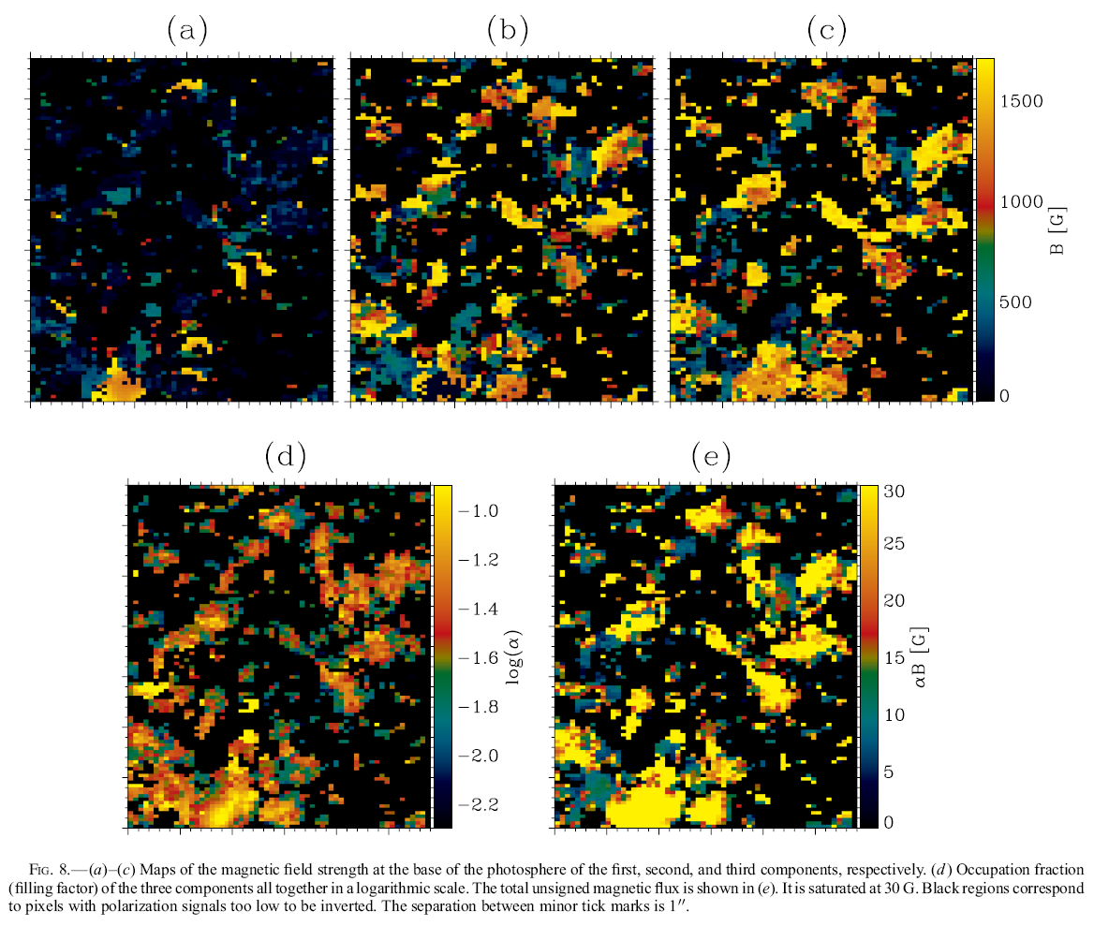
ApJ (2006) 646, 1421

Slide 75
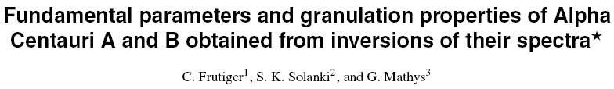

Slide 76
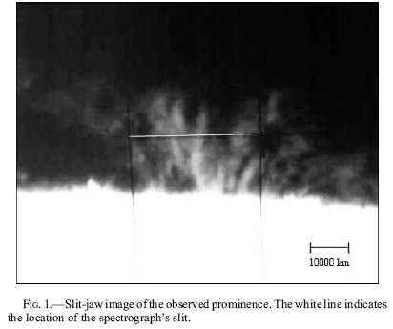

Slide 77
Inversions based on ME atmospheres
ME atmosphere:
Source function is linear with optical depth
Absorption matrix does not vary with optical depth
Analytical Stokes profiles
Fast inversion
Smooth maps of physical quantities
Results are reasonably accurate and easy to interpret

Slide 78
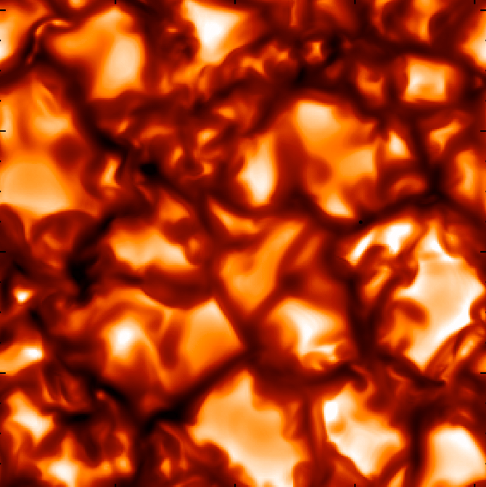


ME inversions of high-spatial resolution profiles
MHD simulations (Vögler et al. 2005)
• Fe I 630.1 and 630.2 nm profiles degraded to Hinode/SP resolution and pixel size

Slide 79


ME inversions of high-spatial resolution profiles
MHD simulations (Vögler et al. 2005)
+
ME inv
Profiles reasonably well fitted
ME results are some kind of “average” of physical parameters along the LOS
ME inv

Slide 80


ME inversions of high-spatial resolution profiles
MHD simulations (Vögler et al. 2005)
Magnetic field strength
Field inclination
Inferred field strength
Inferred field inclination
Atmospheric parameters from MHD simulation at log τ = -2
Maps of inferred B and γ
similar to real ones!
Orozco Suárez et al. 2007, ApJ, 662, L31

Slide 81
Inversions based on ME atmospheres
ME atmosphere:
Source function is linear with optical depth
Absorption matrix does not vary with optical depth
Analytical Stokes profiles
Fast inversion
Smooth maps of physical quantities
Results are easy to interpret
Simplistic treatment of radiation transfer
Little thermal information. No height variations
Cannot account for asymmetric Stokes profiles

Slide 82


Accounting for asymmetries
Basilio Ruiz Cobo

Slide 83





Asymmetric Stokes profiles
Continuum intensity
Stokes V at λ = -3.8 p m
+
+
TESOS+VIP, Sep 2006
KIS/IAA Visible Imaging Polarimeter + TESOS + KAOS
VTT, Observatorio del Teide
Spatial resolution: ∼0.4"
Quiet Sun at center, Fe I 630.15 and 630.25 nm
3rd SOLARNET School, 18-23 May 2015, Granada, Spain Luis Bellot Rubio

Slide 84





The origin of asymmetries
Amplitude asymmetry/ Multi-lobed Stokes profiles
Area asymmetry
Different magnetic atmospheres coexisting in resolution element
Gradients/discontinuities of B
and v_{LOS} along LOS
Auer & Heasley (1978)
RF of Stokes V to B
The area asymmetry gives information on the height variation of atmospheric parameters
Cabrera Solana et al. (2005)
Basilio Ruiz Cobo

Slide 85
Accounting for asymmetries
Inversion codes capable of dealing with asymmetries
Are based on numerical solution of RTE
Provide reliable thermal information
Use less free parameters than ME codes
Infer stratifications of physical parameters with depth
Basilio Ruiz Cobo

Slide 86

Accounting for asymmetries
Basilio Ruiz Cobo

Slide 87

Accounting for asymmetries
Basilio Ruiz Cobo

Slide 88

Accounting for asymmetries
Basilio Ruiz Cobo

Slide 89

Be careful with the choice of atmospheric model!
The results change if the physical model is changed
Too simplistic models; often they cannot describe the real atmosphere
BUT: we get information about the magnetic structure of the atmosphere!
2.5
2.0
1.5
1.0
0.5
0.0
Flux tube model
B [kG]
-5 -4 -3 -2 -1 0 1 2
log tau
Fe I 630.2 nm
1.0
0.9
0.8
0.7
0.6
0.5
0.10
0.05
I/I_{QS}
V/I_{QS}
0.00
Magnetic flux tubes in facular regions
-0.05
-0.10
-400
-200
0 200 400
-400 -200
0 200 400
Lambda [mA]
Lambda [mA]
Basilio Ruiz Cobo

Slide 90
Be careful with the choice of atmospheric model!
The results change if the physical model is changed
Too simplistic models; often they cannot describe the real atmosphere
BUT: we get information about the magnetic structure of the atmosphere!
2.5
2.0
1.5
1.0
0.5
0.0
Flux tube model Best-fit 1C model
B [kG]
-5 -4 -3 -2 -1 0 1 2
log tau
Fe I 630.2 nm
11..00
00..99
00..88
00..77
00..66
00..55
00..1100
00..0055
II//II_{QQSS}
VV//II_{QQSS}
00..0000
Magnetic flux tubes in facular regions
--00..0055
--00..1100
--440000
--220000
00 220000
440000
--440000 --220000
00 220000
440000
LLaammbbddaa [[mmAA]]
LLaammbbddaa [[mmAA]]
Basilio Ruiz Cobo

Slide 91
Be careful with the choice of atmospheric model!
The results change if the physical model is changed
Too simplistic models; often they cannot describe the real atmosphere
BUT: we get information about the magnetic structure of the atmosphere!
22..55
22..00
11..55
11..00
00..55
00..00
Flux tube model Best-fit 1C model
BB [[kkGG]]
--55
--44
--33
--22 --11
lloogg ttaauu
00 11 22
Fe I 630.2 nm
11..00
00..99
00..88
00..77
00..66
00..55
00..1100
00..0055
II//II_{QQSS}
VV//II_{QQSS}
00..0000
--00..0055
--00..1100
EXERCISE 3
Facular profiles from ASP
--440000
--220000
00 220000
440000
--440000 --220000
00 220000
440000
LLaammbbddaa [[mmAA]]
LLaammbbddaa [[mmAA]]
Basilio Ruiz Cobo

Slide 92
Available codes for inversions with gradients
SIR
Ruiz Cobo &
del Toro Iniesta (1992)
Bellot Rubio et al. (1996)
1C & 2C atmospheres, arbitrary stratifications, any photospheric line
Flux tube model, arbitrary stratifications, any photospheric line
NLTE line transfer, arbitrary stratifications
Uncombed penumbral model, arbitrary stratifications
Canopy-like atmospheres
SIR/FT
SIR/NLTE SIR/GAUS
Socas-Navarro et al. (1998)
Bellot Rubio (2003)
SIR/JUMP
Bellot Rubio (2007)
SPINOR
Frutiger & Solanki (2001)
1C & 2C atmospheres, arbitrary stratifications, any photospheric line, molecular lines, flux tube model, uncombed model
1C & 2C, NLTE, arbitrary stratifications
MISMA model, arbitrary stratifications, any photospheric line
NICOLE MISMA IC
Socas-Navarro et al (2015)
Sánchez Almeida (1997)

Slide 93
Tips and tricks
First of all, look at the profiles
Try a ME-like inversion, it usually works
For example, use 1C SIR inversion with height-independent atmospheric parameters
If the V profiles are very asymmetric, fit only I, Q, and U
Examine the fits: are they reasonably good?

Slide 94









1C SIR inversion of Hinode/SP data
EXERCISE 2
Dark-cored penumbral filament

Slide 95
Tips and tricks
First of all, look at the profiles
Try a ME-like inversion, it usually works
If the V profiles are very asymmetric, fit only I, Q, and U
Examine the fits: are they reasonably good?
Identify
Pixels with bad fits and/or large asymmetries
Regions where interesting physical processes occur
Run more complex inversions on these pixels
Which model are you going to use?
1C model, 2C model, flux tube model, uncombed model?

Slide 96
Tips and tricks
First of all, look at the profiles
Try a ME-like inversion, it usually works
If the V profiles are very asymmetric, fit only I, Q, and U
Examine the fits: are they reasonably good?
Identify
Pixels with bad fits and/or large asymmetries
Regions where interesting physical processes occur
Run more complex inversions on these pixels
Which model are you going to use?
1C model, 2C model, flux tube model, uncombed model?
Use ME results as initialization
Give more weight to the strangest Stokes parameter
Keep it simple! See if linear stratifications (2 nodes) are sufficient
Ask yourself if the retrieved model atmosphere makes sense!!
Experts are always around: ask them for advice!

Slide 97


Running SIR: input files
CONTROL FILE
PROFILE FILE
Input files
Line Δλ
index [mA]
I/I
Q/I U/I_{qs} V/I_{qs}
qs
qs
read_profiles.pro write_profiles.pro

Slide 98

Running SIR: input files
WAVELENGTH GRID FILE

Slide 99

Running SIR: input files
ATOMIC PARAMETER FILE
Line index
Atom λ E
χ
log gf
transition

Slide 100


Running SIR: input files
MODEL FILE
read_model.pro write_model.pro modelador3.x
log τ T P_{e}
^{v}mic
B
^{v}LOS
γ
ϕ z [km] P_{g}
ρ

Slide 101

Concept of nodes
Keeping the number of free parameters small:
Atmospheric parameters perturbed in coarse grid (nodes)
Full stratifications in finer grid by cubic spline interpolation

Slide 102
Executing the inversion
echo sir.trol | sir.x

Slide 103



Visualizing SIR results: graphics2.pro
Model atmospheres
Stokes profiles
Basilio Ruiz Cobo

Slide 104
SIR exercises
Download exercises from
http:/SIR/SIR_exercises.tar
3rd SOLARNET School, 18-23 May 2015, Granada, Spain Luis Bellot Rubio

Slide 105
Exercise 1
Spectral synthesis and inversion of synthetic profiles
Use HSRA model to synthesize Stokes profiles with
constant B, inclination and v_{LOS} (e.g., 1 kG, 60º, 2 km/s)
constant v_{LOS}, gradients of B and inclination
gradients of B, inclination and v_{LOS}
Invert profiles from (3), starting from initial guess model with flat stratifications of B, v_{LOS}, and inclination (modify hsra.mod)
1 node in B, vlos, inclination
2 nodes in B, v_{LOS} and inclination
read_model,filename,tau,t,pe,mic,b,vel, gamma,phi,mac,filling,sl b=1000.+200* tau write_model,filename,tau,t,pe,mic,b,vel,gamma,phi,mac,filling,sl
3rd SOLARNET School, 18-23 May 2015, Granada, Spain Luis Bellot Rubio

Slide 106
Exercise 2
Inversion of profiles from dark-cored penumbral filament
Hinode/SP observations with SNR~1000, no telluric lines, two lines Fe I 630.1 and 630.2 nm
Strong, symmetric signals
What kind of model would you use to invert them?
Can the fit be improved with more nodes in T? (use 2 cycles!)
What happens with 2 nodes in B and v_{LOS}?
What happens with 10 nodes in B and v_{LOS}?
If no instrumental PSF is available, use macroturbulence to mimick its effect (i.e, invert v_{mac}) Use more weight for Q, U and V to force better fits to those parameters
A worse equivalent SNR does not necessarily mean a worse fit (i.e., a lower chi²) Beware of models with too much freedom!
3rd SOLARNET School, 18-23 May 2015, Granada, Spain Luis Bellot Rubio

Slide 107
Exercise 3
Inversion of facular profiles in quiet Sun
Advanced Stokes Polarimeter observations, averaged over facular region, SNR~10000, but poor spatial resolution
Two lines Fe I 630.1 and 630.2 nm (plus telluric lines!)
Strong signals, large Stokes V area and amplitude asymmetries
What kind of model would you try to invert them?
Use two cycles, increasing number of nodes in 2nd cycle
Invert stray-light fraction, micro- and macro-turbulence
We invert Stokes I and V only, so vertical fields should be assumed
Use large negative number (e.g., -2) in profiles to ignore blends in Stokes I during inversion Use instrumental PSF and macroturbulence at the same time
Use stray light profile
Use weights of 10 and 100 for Stokes V
3rd SOLARNET School, 18-23 May 2015, Granada, Spain Luis Bellot Rubio

Slide 108
Exercise 4
Inversion of quiet-Sun internetwork profiles
Hinode/SP observations at disk center, integrated for 6 min, SNR~10⁵, still high spatial resolution
Two lines Fe I 630.1 and 630.2 nm
Extremely weak signals, but linear polarization clearly seen. Large asymmetries.
What kind of model would you try to invert them?
Use three cycles with increasing number of nodes
Invert stray-light fraction and microturbulence (flat stratification)
Interpret resulting model
No need for macroturbulence when high-resolution data are inverted using telescope PSF Use following weights: 1,4,4,4
3rd SOLARNET School, 18-23 May 2015, Granada, Spain Luis Bellot Rubio

Slide 109
Exercise 5
Inversion of sunspot penumbral profiles near PIL
Hinode/SP observations with SNR~1000, no telluric lines, two lines Fe I 630.1 and 630.2 nm
Strong signals, but Stokes V profile with three lobes......
What kind of model would you use to invert them?
One-component model with opposite magnetic polarities along LOS? Two-component model?
Try both!
Inversion of these profiles will not be easy. Do your best!
Give more weight to Stokes V to force better fits. Increase weight with cycle If everything fails, use superpowers...
3rd SOLARNET School, 18-23 May 2015, Granada, Spain Luis Bellot Rubio

Slide 110
Exercise 6
Internetwork profiles with very weak Q, U signals
Simulated Hinode obs, SNR~800, Fe I 630.1 and 630.2 nm
Synthesize Stokes profiles from 2 component model:
magnetic atmosphere with B=200 G, γ = 10º, filling factor=5%
non-magnetic atmosphere (hsra.mod), filling factor=95%
Save profiles. Then add noise at the level of 10⁻³ using
add_noise,filename,1.25e-3. Save the noisy profiles.
Invert noise-free, then noisy profiles. Use simple 2C model, freezing 2nd component to hsra.mod.
Interpret resulting field inclinations.
If you are curious (you should!), repeat exercise with only one line
Use 2C models for synthesis and inversion
Beware of noisy linear polarization profiles, especially when only one line is available!
3rd SOLARNET School, 18-23 May 2015, Granada, Spain Luis Bellot Rubio

Slide 111
Exercise 7
Inversion of CRISP profiles from sunspot penumbrae
SST/CRISP observations with SNR~500, sequential spectral sampling of Fe I 617.3 nm (30 wavelengths in ~30 s)
Strongly Doppler-shifted polarization profiles
What kind of model would you use to invert them?
Try stray-light contamination, 1C or 2C model
You are on your own! I have not inverted these profiles yet...
Example of Stokes profiles observed with a Fabry-Pérot interferometer
Extremely high spatial resolution, but modest spectral resolution (~50 mA at 617 nm) Sequential sampling of line means first and last wavelengths are observed ~30 s apart
3rd SOLARNET School, 18-23 May 2015, Granada, Spain Luis Bellot Rubio

Slide 112
Stray-light considerations
Stray-light in 1C inversions:
I_{obs}= (1-α) I₁ + α I_{stray}
Accounts for both stray light and/or magnetic filling factor
Stray-light in 2C inversions:
It is NOT equivalent to a magnetic filling factor
SIR has two free parameters: α and f
– I_{obs}= (1-α) [f I₁ + (1-f) I₂] + α I_{stray}
Global vs local stray-light profile
Classical treatment: global stray-light profile (average over FOV)
Orozco Suárez et al. (2007): local stray-light profile accounts for telescope diffraction
Basilio Ruiz Cobo

